Slide 1


Project name: Remote Thermal Viewing within High Voltage Team members: Blake Bagley, Julia Garcia, Erica Mathew

Slide 2
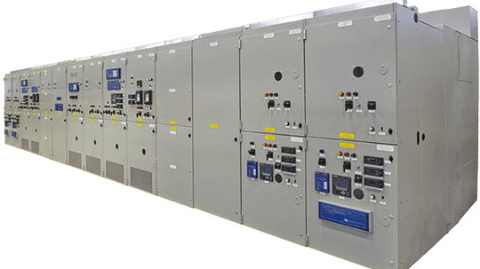

Project description
Problem statement: “As industry demand grows, space inside medium voltage switchgear has become increasingly limited. Manufacturers are required to fit more devices and wires within the same limited space. Additionally, manufacturers are now being asked to include a remote viewing system within the switchgear to monitor a physical ground switch. This ground switch is physically blocked, by wires, from the view of the operator.”
Notes:
Erica: Our project sponsor is powell industries which is a “Powell Industries designs and manufactures equipment like switchgear, circuit breakers, and power management systems that help safely control and distribute electrical power in multiple different industries
Switchgears are Switchgears are devices that control and protect electrical circuits by turning power on or off and preventing damage during electrical faults.
Powell industries designs/maufactures
explain switchgears
explain project

Slide 3
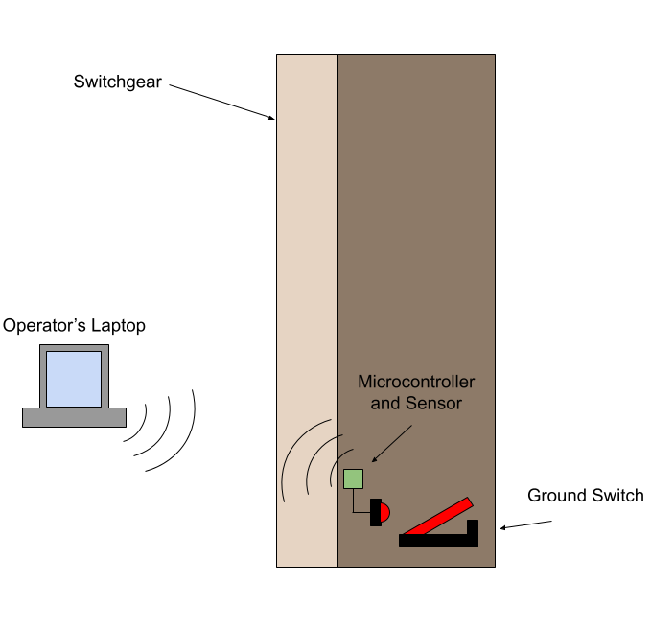
Project Solution Description
Solution proposal: Our solution to this problem is to create a thermal remote viewing system that an operator can connect to through Wi-Fi, allowing for operators to confirm the grounding switch is either open or closed through video and automation. This will make switchgear operators jobs safer and more convenient.
Notes:
Blake

Slide 4
System Overview
Power Supply
Thermal Sensor
Battery
Website
Converters
Microcontroller
Julia, Blake, Erica
Notes:
Julia

Slide 5
Task partition
Julia: Design the power supply and overall hardware of the system.
Blake: Microcontroller coding and ML
Erica: Creating Web Application for users to interact with
Notes:
erica

Slide 6
Thermal Sensor and accompanying PCB (Julia)
FLIR Lepton 3.5 Thermal Image Sensor
Buck Converter (3.7 V -> 1.26V)
VDDC
Buck Converter (3.7 V -> 2.88V)
VDD
3.7 V Lithium Polymer Battery Pack
Buck Converter (3.7 V -> 3.1V)
VDDIO
ESP32
MCU
Buck Converter (3.7 V -> 3.6V)

Slide 7
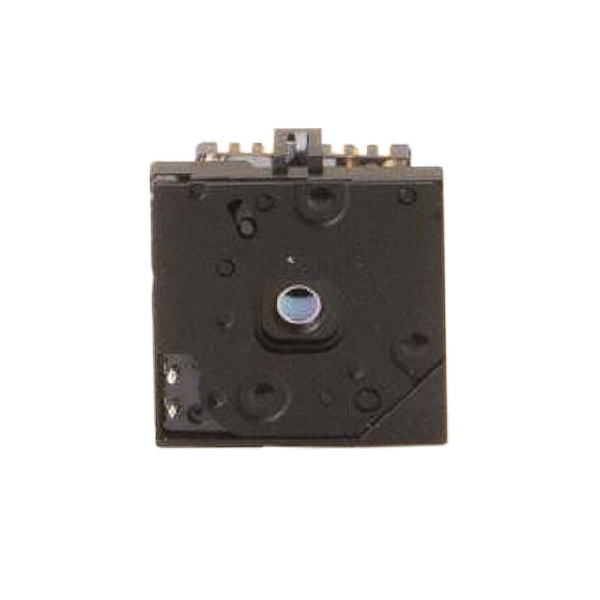
Thermal Sensor and accompanying PCB (Julia)
Completed:
Main parts chosen and ordered
Power Source
Thermal Image Sensor
Chosen Enclosure Material
UHMW (ultra-high molecular weight) polyethylene
In progress:
Subsystem introduction project
will finish on 9/30
Buck Converter design
need to find pwm chips
planning to have the design and simulation done on 10/7
Plan to have the PCB ordered by design blitz so I can work on the physical part during the blitz.
Notes:
jay update: finished designing the buck converters, ran simulations, will be ordering parts on monday

Slide 8
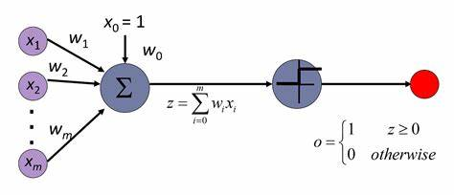
Microcontroller (Blake)
The job of the microcontroller will be to take the video from the thermal sensor and send it to the designated website through wifi.
Another feature that will be included in the microcontroller is the use of ML.
Image Recognition
Switch-State Determination
In progress:
Completed Subsystem Introduction Project
Training Data for Image Recognition

Slide 9


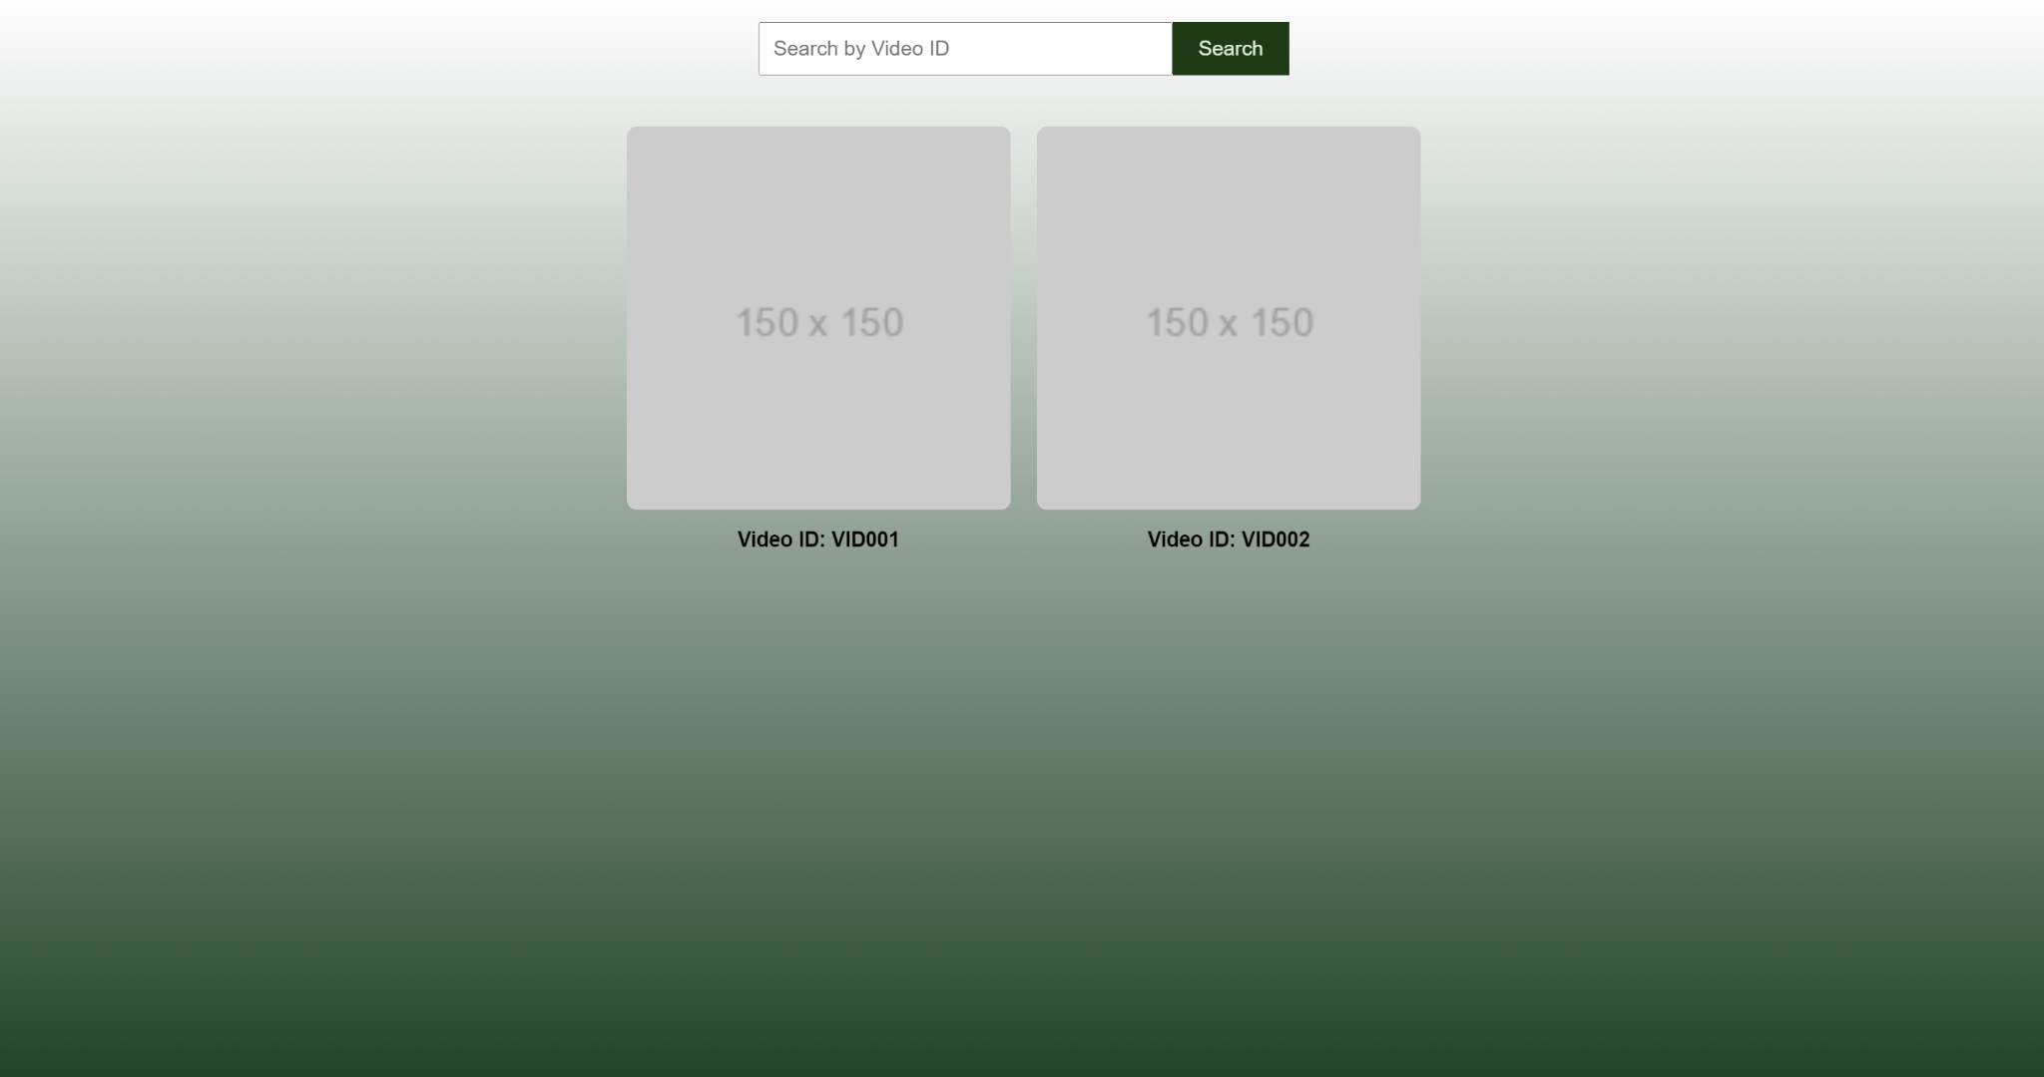
Web Application (Erica)
Completed:
Subsystem Introduction Project
Login + Registration + Overview Pages
Local database to test functionality
In Progress:
Search functionality
Video page
Learn how to stream data from a live video feed
Add more features for operator convenience
Using:
HTML, CSS, JavaScript, Node.js.
Notes:
Breakdown of layout: login page that leads to a overview page displaying multiple video streams. When you search the ID number or click the icon it will direct you to the video page which is a bigger stream that will display video aswell as a label ‘open or closed’
So far, I’ve successfully implemented the login and registration system, which provides secure user authentication. I've also built overview pages that give users a quick summary of key information. To test all of these functionalities, I’ve set up a local database, ensuring everything works smoothly before moving to production.
Right now, I’m working on a few more advanced features. One of the main ones is adding search functionality to help users find specific video feeds quickly by entering a video ID. Additionally, I’m developing a video page that will display video content. Im also working on how I am going to stream data from a live video feed.
Moving forward, I plan to add more features to further enhance operator convenience, making the system even more user-friendly.
Technically, I’m using a stack that includes HTML, CSS, JavaScript, and Node.js, and I’m leveraging these technologies to ensure both front-end and back-end components are efficiently integrated."

Slide 10
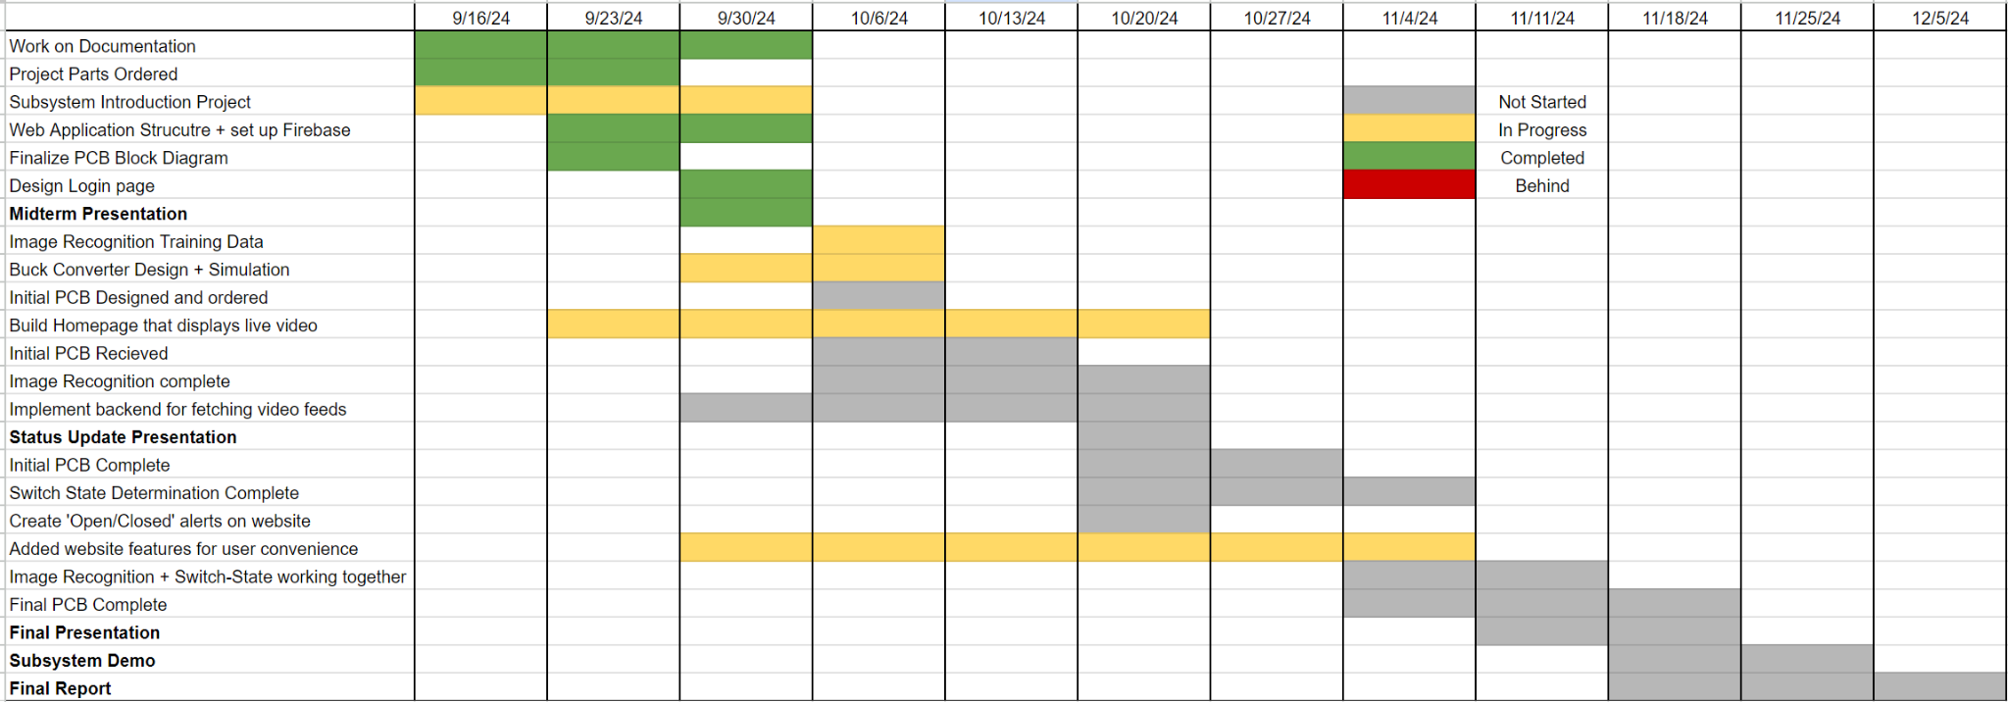
Execution plan

Slide 11
Validation Plan
Subsystem | Task | Detail | Data | Pass/Fail
Thermal Sensor (Julia) | Provide Power | Input Voltage reads ~3.7 V, Microcontroller turns on, Sensor turns on
 | Buck Converters | Output to VDDC reads ~1.26 V, Output to VDD reads ~2.88 V, Output to VDDIO reads ~3.1 V, Output to ESP32 reads ~3.6 V, Receiving signal from microcontroller
 | Sensor Sending Video | Signal is coming from output
Microcontroller (Blake) | Image Recognition Accuracy (90%) | Make sure the accuracy of the Image Recognition is to standard when close or far, centered or not.
 | Switch-State Determination Accuracy (90%) | Make sure the accuracy of the Switch-State Determination is to standard when close or far, centered or not.
 | Receiving Video from Sensor
 | Sending Video to Website
Website Application (Erica) | Receiving Video | If video is not fetched after 30 seconds, an error will appear. Video should output with no more than 5 second delay. Video should be of correct vertical tower
 | Login-in System | Login with correct credentials and fail with incorrect credentials
 | Search Bar | Search bar redirects user to the proper video stream
 | Video Display Page | Overview Page that displays multiple video streams. Video streams in overview page are clickable to redirect user to zoomed in video feed on a different page

